Slide 1


Slide 2
Falls and Fall Prevention
Your Place Is Here
Juliana Kalipeni, MSN, RN
Shanné Grandison, CEO, Owner

Slide 3
Agenda
Why falls matter
Common causes of falls
How to reduce fall risk
What to do if you feel unsteady
What to do if you experience a fall

Slide 4
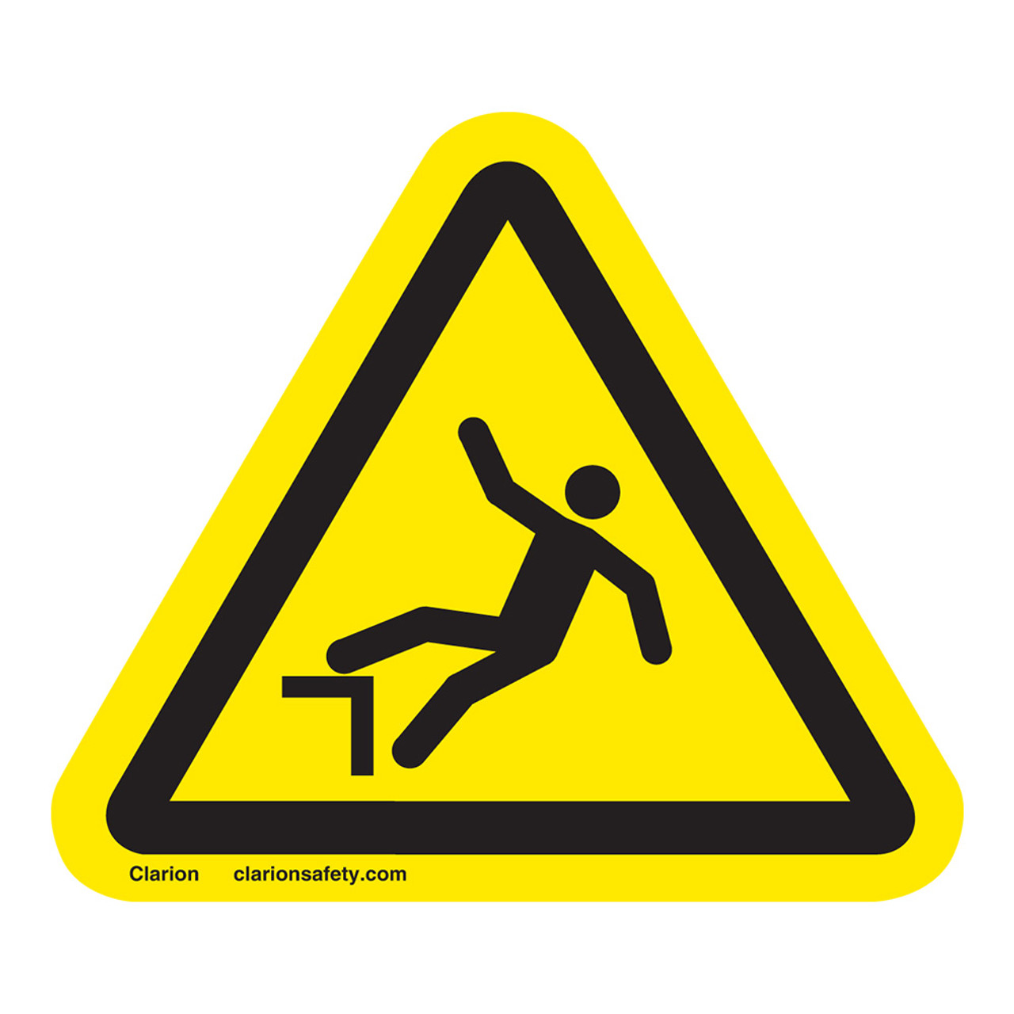
Why Falls Matter
Falls are the leading cause of injury in adults 65 and older.
They can cause fractures, hospitalizations, fear of falling, and reduced independence.
Most falls are preventable with simple steps and awareness.
Notes:
1 in 4 older adults report a fall each year , more than half of these falls occur at home. Can you guess the 3 most common places in the home where falls occur? Bedroom, bathroom, and on stairs
In 2023 the Indiana government reported 685 deaths among older adults due to unintentional falls.
75,000 older adults went to the emergency department due to falls and 13,000 of them needed to be hospitalized.

Slide 5
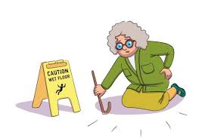
Common Causes of Falls
Physical Factors
Medical and Medication-Related Factors
Environmental Hazards
Notes:
Physical: muscle weakness, balance problems, dizziness, vision changes, foot pain or improper footwear
Medical: low blood pressure, sedatives, sleep aids, multiple medications, chronic conditions such as arthritis, diabetes, heart disease, neuropathy
Environmental: Clutter, loose rugs, poor lighting, wet floors, unstable furniture, lack of grab bars or handrails in bathrooms

Slide 6
How to Reduce Fall Risk
Improve strength and balance | Review medications | Get regular vision and hearing checks | Make your living space safer | Use assistive devices correctly
Participate in regular exercise programs. Aim to move your body daily, even in small ways. | Ask your doctor or pharmacist to review your medications at least once a year. Report dizziness, sleepiness, or balance changes to your doctor. | Update glasses and eye exams as rec. by your doctor. Clean smudges off glasses daily. Hearing issues can affect balance too. | Keep pathways clear. Ensure good lighting Use non-slip mats Wear supportive, non-slip shoes/socks | Use canes, walkers, or handrails as recommended. Avoid carrying items in your hand – use walker baskets or bags.

Slide 7
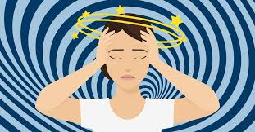
What to do if You Feel Unsteady
Sit down immediately if you feel dizzy or lightheaded.
If you can, check your blood pressure.
Rise slowly from beds or chairs to prevent sudden drops in blood pressure.
Call for help, do not try to walk alone.
Notes:
Give example of low blood pressure 80’s/40-50’s

Slide 8
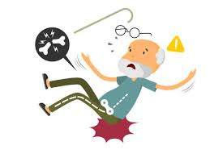
If You Experience a Fall
Stay calm and breathe slowly
Assess yourself for pain, numbness, or dizziness
Look for visible injuries
Call for help: 911, neighbor, or family/friend
If you can crawl, roll, or scoot to get to your phone if it is not nearby
DO NOT try to get up if you are injured

Slide 9

Final Tips & Takeaways
Keep your body strong
Review medications
Keep vision and hearing updated
Make your home safe
Use assistive devices correctly
If you feel unsteady sit down right away
If you fall and are injured call for help
Notes:
1. Join exercise or stretching groups 2. Ask your doctor or pharmacist to review all your medications 3. Wear your most current glasses, keep your lenses clean, good hearing helps with balance 4. keep walkways clear and clutter free, use good lighting, use grab bars and non slip rugs and mats 5. make sure your cane or walker fits your height, use a walker basket to keep hands free

Slide 10
Basic First Aid for Everyday Safety
Your Place Is Here
Juliana Kalipeni, MSN, RN
Shanne Grandison, CEO

Slide 11
Agenda
What is first aid
First aid for falls
First aid for cuts and scrapes
First aid for burns
First aid for choking
First aid for nosebleeds
First aid for chest pain
First aid for a suspected stroke

Slide 12
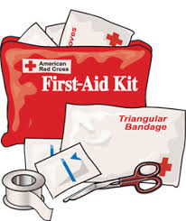
What Is First Aid?
First aid means helping yourself or someone else quickly after a minor accident.
You do not need medical training to assist with basic first aid.

Slide 13
First Aid for Falls
If uninjured slowly roll onto your side and take a moment and get up slowly
If you are injured call for help
If someone else falls do not lift them alone, keep them still and comfortable, and call for help

Slide 14

First Aid for Cuts and Scrapes
Apply gentle pressure with gauze (or a clean cloth) to slow the bleeding
Wash with soap and water when the bleeding slows down
Apply antibiotic ointment if appropriate and cover with a clean bandage
SEEK MEDICAL HELP IF:
Bleeding does not stop
The cut is deep- requiring stitches
You take blood thinners

Slide 15
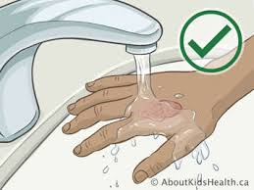
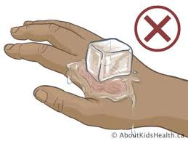
First Aid for 1st Degree Burns
First degree burn is a minor burn that makes the top layer of skin red, painful, and dry but does not blister. Usually heals within 3-7 days
Run cool- not cold-water over the area for 10 minutes
Do not use ice, butter, or oils
Cover lightly with a clean cloth
SEEK MEDICAL HELP IF:
Skin is blistered
Burn is larger than a hand
Burn is on face, hands, or groin
Notes:
1st degree burn: Is a minor burn that makes the top layer of skin red, painful, and dry bur does not blister.
Ice is too cold and can cause more tissue damage and delayed healing.
Oils and butter trap the heat under the skin which can make the burn worse

Slide 16
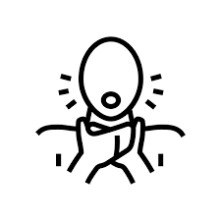
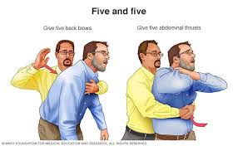
First Aid for Choking
If you are choking:
Cough forcefully
If you cannot breathe or talk, use the universal choking sign (hands on throat)
Someone near by should perform abdominal thrusts if needed
If someone else is choking:
Ask them “Are you choking?”
You can administer 5 back blows
Position them for the Heimlich maneuver- abdominal thrusts
https://www.youtube.com/watch?v=bNwXnJQqA-g&t=123s
Notes:
Some sources only teach the abdominal thrust. It's OK not to use back blows if you haven't learned the back-blow technique.
For abdominal thrust stand behind the person and wrap your arms around their torso. Make a fist with one hand and grasp that fist with the other hand. Place your hands just above the belly button and below the ribcage. Quickly pull inward and upward to expel the blockage.
VIDEO DEMONSTRATIO: https://www.youtube.com/watch?v=bNwXnJQqA-g&t=123s

Slide 17
First Aid for Nosebleeds
Lean forward, not back
Pinch the soft part of the nose (just below the bridge) for 10-15 minutes
Use tissues or a clean cloth
SEEK MEDICAL HELP IF:
Bleeding lasts more than 20 minutes
You take blood thinners
You feel faint
Notes:
Leaning backwards can cause blood to flow into your mouth and throat which can cause nausea, vomiting, or choking. It also makes it easier to tell if the blood is slowing down.

Slide 18
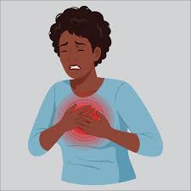
First Aid for Chest Pain
Call 911 immediately- this can be a sign of a heart attack
Sit down and rest
Follow any steps your healthcare provider may have given you previously about medications if applicable
Do not attempt to drive yourself to the hospital
CHEST PAIN IS ALWAYS AN EMERGENCY

Slide 19
First Aid for Suspected Stroke
Call 911 immediately
Keep the person sitting or lying safely
Note the time symptoms started
Assessing the person: BE FAST
Balance- Sudden loss of balance, dizziness, or extreme headache
Eyes- Sudden onset of blurred vision
Face- Ask the person to smile, is one side drooping?
Arm- Ask them to raise both arms, does one arm drift down?
Speech- Ask them to repeat a simple sentence, is their speech slurred or strange?
Time- Take note of the time you noticed symptoms or the last time you saw the person well.

Slide 20
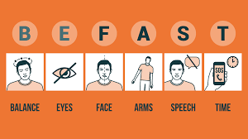
Notes:
Every year in the US about 795,000 people have a stroke. 77% of those strokes occurred in people 65 and older. Unfortunately, the risk of stroke increases with age.
Other risk factors include high blood pressure, heart conditions, diabetes, high cholesterol, smoking, obesity, excessive alcohol usage, race (African Americans, Native Americans, some Hispanic/Latino groups) and gender (women) .

Slide 21
When to Call 911 Immediately
Trouble breathing
Chest pain or pressure
Sudden weakness or numbness
Serious bleeding- especially while on blood thinners
Confusion or sudden behavior change
A fall where you hit your head

Slide 22
Thank you

