Slide 1

DRIVER
101

Slide 2
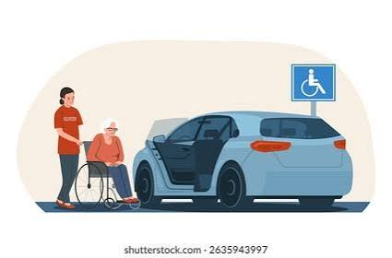
PROVIDING RIDER ASSISTANCE

Slide 3
GETTING INTO THE VEHICLE
Guide the passenger to back up until the back of their legs touch the car seat.
Have them reach back for a stable surface, car handle, or dashboard—not the door edge.
Instruct them to sit down sideways on the edge of the seat first.
Protect their head from the door frame as they pivot or lift their legs inside one at a time.
https://www.youtube.com/watch?v=BJ5UZ-Kjp60&t=28s
GETTING OUT OF THE VEHICLE
Swivel the passenger's legs so they face the open door and swing them outside.
Help them scoot forward on the seat until both feet are firmly planted on the ground.
Instruct them to lean forward ("nose over toes") to shift weight before standing.
Support them to a standing position and transition their hands to a walker, cane, or stable support.
https://www.youtube.com/watch?v=BJ5UZ-Kjp60&t=28

Slide 4

GROCERY DELIVERIES

Slide 5
ONLINE ORDERS
Get added as a delegate: Have the account holder add your name and phone number to the order via the store or app settings (like Sam's Club, Walmart, etc.) before you head out.
Save the details: Keep the confirmation text message, email, or digital barcode handy, as store staff may scan it or ask for the order number.
Bring your ID & badge: in case the store employee asks to verify your identity against the authorized pickup list.
Check in at the store: Follow the curbside signs or go to the in-store pickup counter, then give the associate the order name and number.
IN-STORE
Drive client to their desired store
Load vehicle with the groceries
Drive client home
Unload the groceries for the clients per their request

Slide 6

PHARMACY DELIVERIES

Slide 7
Have the client call the pharmacy to ensure their medication(s) are ready for pick up.
You generally only need the patient's full name, address, and date of birth.
If you are picking up a controlled substance (like strong pain relief or ADHD medication), you will also need to show your own valid photo ID and sign for the medication.
DO NOT open the closed pharmacy bag or any of the medications. Have the client verify they have received the right medications upon delivery.

Slide 8

SUBMITTING MILEAGE REIMBURSEMENTS

Slide 9
To be completed at the end of each day
www.teamypih.org
Fill out the form. You will need the client’s name and DOB
Don’t forget to hit submit!

Slide 10

SAFETY IS IMPORTANT!

Slide 11
Ensure that you & all passengers buckle up
Turn your dash cam on during each ride for your safety & theirs
Ensure that your tracker is in your vehicle during each ride for your safety & theirs
Don’t text & drive
Drive the speed limit
Trust your instincts, be aware of your surroundings!
Communicate if you’re lost, delayed, or having an emergency
  Office: 463-224-8558
  Cell: 317-572-7197

Slide 12

VEHICLE INSPECTIONS & MAINTENANCE

Slide 13
Complete your Initial & Quarterly inspection by YPIH
  Is your vehicle 2011 or newer?
  Does your vehicle appear to be in good condition?
  Is your driver’s license & registration in good standing?
  Is your insurance up-to-date?
Stay fueled up
Get frequent oil changes & vehicle inspections. Your ride is your moneymaker, please take care of her!
Keep your ride clean inside & out, remember first impressions are everything

Slide 14

CONGRATULATIONS!
YOU’RE READY TO HIT THE ROAD!
SET THE STANDARD!
HAVE FUN!
MAKE EVERY RIDE MEMORABLE!

