Slide 1
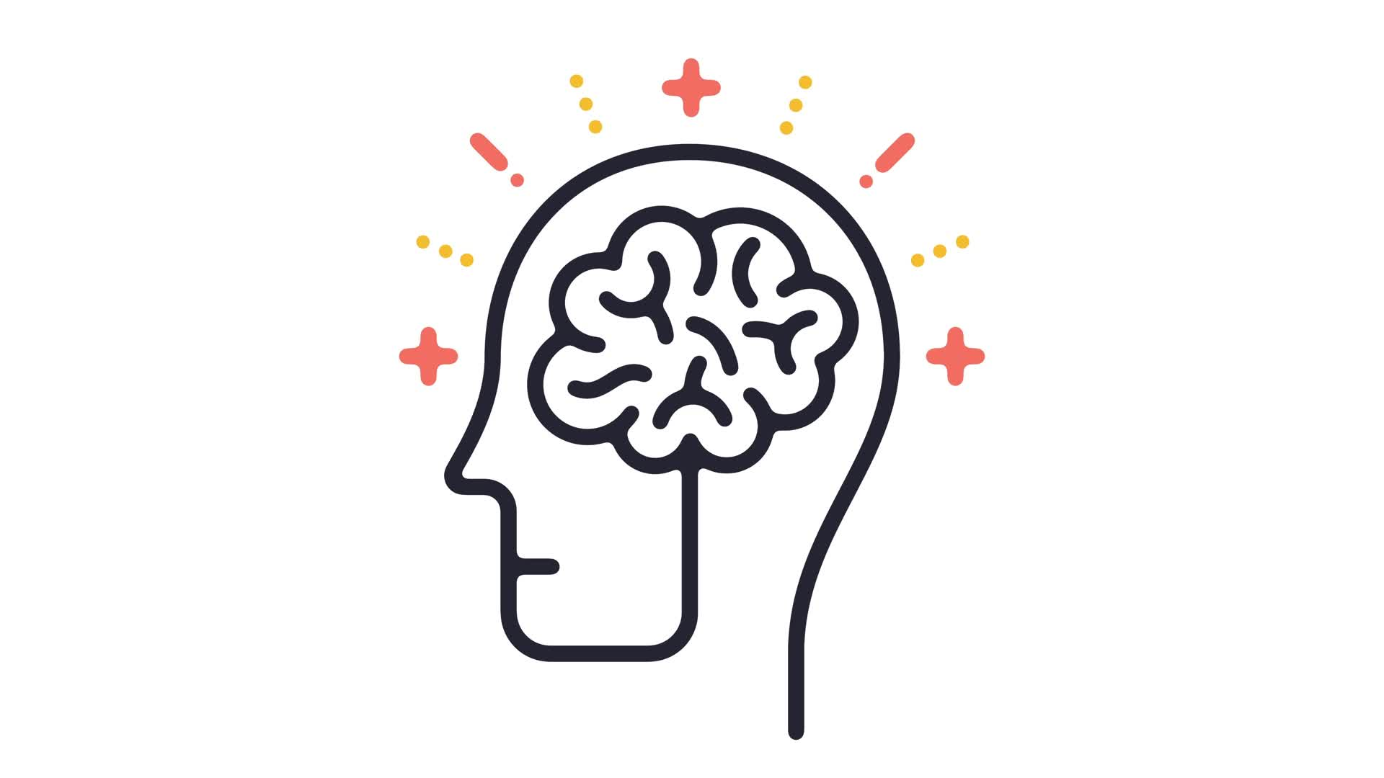
Mental Health
Depression & Anxiety

Slide 2
How can you help?
Communication & Support
Active listening: Be present and attentive when they talk about their feelings, without interrupting or minimizing their experiences.
Validate their emotions: Let them know you understand and believe their feelings are valid.
Express care and concern: Regularly remind them that you are there for them and want to help.
Avoid judgment: Do not criticize or blame them for their struggles
Lifestyle Changes
Regular exercise: Encourage moderate physical activity like walking, swimming, or yoga, which can significantly improve mood.
Healthy diet: Promote a balanced diet with plenty of fruits, vegetables, and whole grains.
Sleep hygiene: Establish a consistent sleep schedule and create a relaxing bedtime routine.
Stress management techniques: Teach relaxation methods like deep breathing, meditation, or progressive muscle relaxation

Slide 3
Engaging Activities
Social interaction: Spend time with loved ones, join social groups, or plan outings to combat isolation.
Hobbies and interests: Encourage them to participate in activities they enjoy, like reading, music, art, or gardening.
Mindfulness practices: Introduce mindfulness exercises to focus on the present moment.
Professional Support
Therapy: Suggest seeking professional therapy from a psychologist or counselor.
Medication review: If they are taking medication, ensure they are following their doctor's instructions and discuss any side effects.
Medical check-up: Encourage them to consult their doctor to rule out any underlying medical conditions that might contribute to their symptoms.

Slide 4
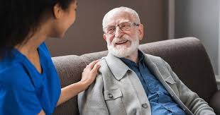
Resources
Dial 911 for Emergent Assistance
Dial 211 for resources in your area
Dial or text 988 to speak with a live counselor
WATCH & LEARN
https://www.youtube.com/watch?v=sn8UME5kik4
https://www.youtube.com/watch?v=HcVAuHxEQfQ

Slide 5

Quiz Time!

